Slide 1

Analyzing Commenting Behavior of News Readers
Guider by: Presented by:
Prof. Bivas Mitra ami ladani
akshay patil
Mentor: Ashwin bhoyar
Abhijnan chakraborti

Slide 2
Dataset
Source : New York Times Online Articles
Articles : 333,331
Sections : 53
Comments : 896,841
Users : 144,614

Slide 3
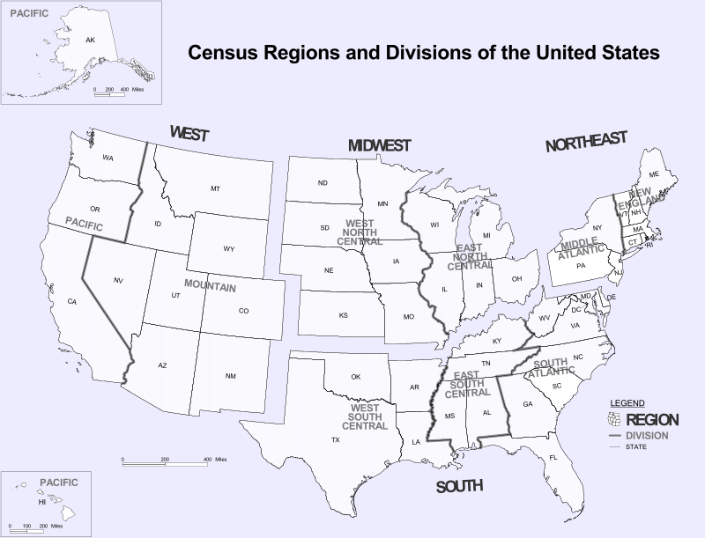
United States regions

Slide 4
Dividing into four United States regions
Divided different regions of U.S. into four regions for our analysis
Region Name | Combined Regions
West | Pacific
 | Mountain
Midwest | West North Central
 | East North Central
South | West South Central
 | East South Central
 | South Atlantic
North East | Middle Atlantic
 | New England

Slide 5
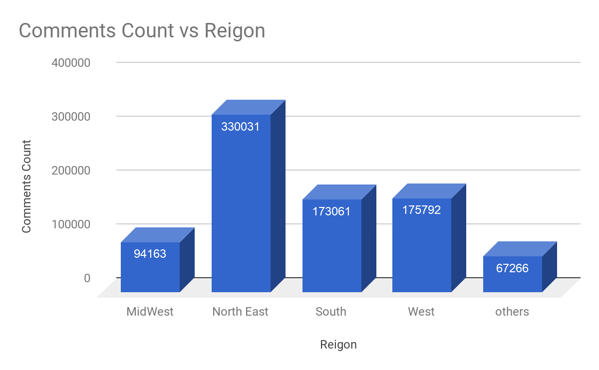
Comments distribution over region
People from North West comments on news articles more than any other regions

Slide 6
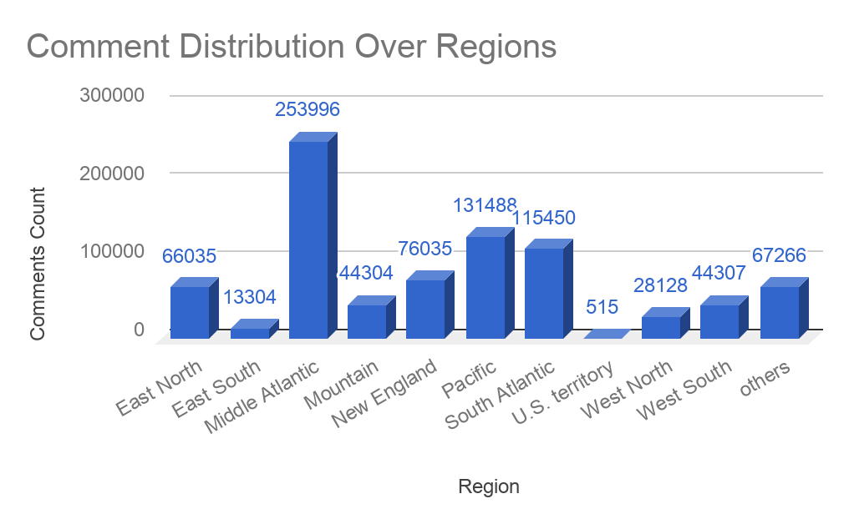
Comments distribution over sub-regions
People from Mid Atlantic sub-region comments more than double to any other region

Slide 7
Comparison of Named Entities
Findings from top 100 entities excluding 15 most commons.
Table shows the entities which showed largest difference in percentage between male and female:
Male | Female
Donald | Hillary
ACA | Bernie Sanders
ISIS | Pope
Krugman | Medicare
Middle East | Christian
Syria | Catholic
Obamacare | God
Wall Street | Facebook
Walmart | Parenthood

Slide 8
Articles of Interest for females
Females in different regions are interested in articles related to different topics:
North East | West | South | Midwest
Global Warming | California | Texas | Walker, Scott K
Immigration and Emigration | Water | Emanuel African Methodist Episcopal Church | Texas
Francis | Drought | Flags, Emblems and Insignia | Francis
Mental Health and Disorders | Computers and the Internet | South Carolina | Immigration and Emigration
Polls and Public Opinion | Conservation of Resources | Roof, Dylann Storm | Israel
Research | Immigration and Emigration | Debates (Political) | Diet and Nutrition
Psychology and Psychologists | Global Warming | Rubio, Marco | Computers and the Internet
Walker, Scott K | Debates (Political) | Walker, Scott K | Global Warming
Computers and the Internet | Mental Health and Disorders | Hate Crimes | Debates (Political)
Debates (Political) | Greece | Computers and the Internet | Research

Slide 9
Articles of interest for males
Males in different regions are interested in articles related to different topics:
North East | West | South | Midwest
Books and Literature | California | Texas | Rubio, Marco
Education (K-12) | Water | Francis | Education (K-12)
Francis | Computers and the Internet | Baltimore (Md) | Polls and Public Opinion
News and News Media | Drought | Rubio, Marco | Francis
Polls and Public Opinion | Debates (Political) | Debates (Political) | Iraq
Rubio, Marco | International Trade and World Market | Polls and Public Opinion | Texas
International Trade and World Market | Series | Greenhouse Gas Emissions | Books and Literature
Baltimore (Md) | China | News and News Media | Computers and the Internet
Embargoes and Sanctions | Rubio, Marco | International Trade and World Market | Baltimore (Md)
Computers and the Internet | Iraq | Computers and the Internet | Wages and Salaries

Slide 10
Articles of interest in Midwest region
Male | Female
Global Warming | Women and Girls
Greece | Colleges and Universities
European Union | Police Brutality, Misconduct and Shootings
Islamic State in Iraq and Syria (ISIS) | Race and Ethnicity
Europe | Supreme Court (US)
European Sovereign Debt Crisis (2010- ) | Parenting
Syria | Law and Legislation
Israel | Labor and Jobs
Rubio, Marco | Social Conditions and Trends
Polls and Public Opinion | Trump, Donald J

Slide 11
Articles of interest in West region
Male | Female
Iran | Parenting
Nuclear Weapons | Children and Childhood
Greece | Education (K-12)
Islamic State in Iraq and Syria (ISIS) | Books and Literature
European Sovereign Debt Crisis (2010- ) | Sex Crimes
Global Warming | New York City
Debates (Political) | Television
International Trade and World Market | Baltimore (Md)
Israel | Wages and Salaries
Eurozone | Conservation of Resources

Slide 12
Articles of interest in south region
Male | Female
Global Warming | Parenting
Europe | Sex Crimes
Greece | Emanuel African Methodist Episcopal Church (Charleston, SC)
European Union | Books and Literature
European Sovereign Debt Crisis (2010- ) | Education (K-12)
Roman Catholic Church | Children and Childhood
Islamic State in Iraq and Syria (ISIS) | Flags, Emblems and Insignia
Economic Conditions and Trends | South Carolina
Francis | Abortion
Rubio, Marco | Television

Slide 13
Articles of interest in north east region
Male | Female
Israel | Parenting
Europe | Children and Childhood
European Union | Television
Greece | Wages and Salaries
Islamic State in Iraq and Syria (ISIS) | Sex Crimes
Homosexuality and Bisexuality | Immigration and Emigration
European Sovereign Debt Crisis (2010- ) | Series
International Relations | Mental Health and Disorders
Walker, Scott K | Abortion
News and News Media | Polls and Public Opinion

Slide 14
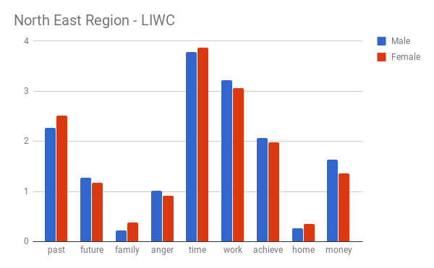
LIWC Analysis
LIWC analysis of North East Region using ??tool
Users discuss Time and Work more than Family and Home
Female users discuss more on Family, Home, Time and Past.
Male users discuss more on Work, Money, Anger, Achievements and Future.

Slide 15
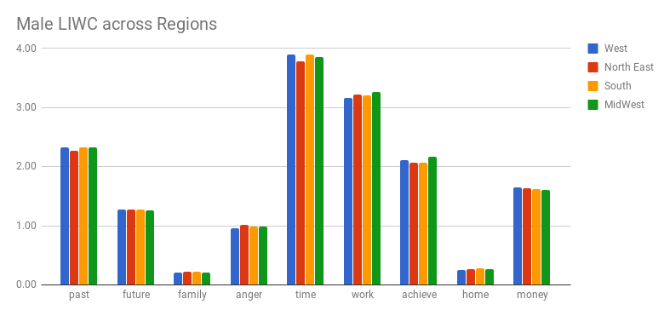
LIWC analysis for males across the region
West discusses more on Time, Money and Future but less on Work, Achievements, Family and Home
MidWest is oriented towards Work and Achievements rather than Time and Money
NorthEast gives less importance to Time and uses aggressive words

Slide 16
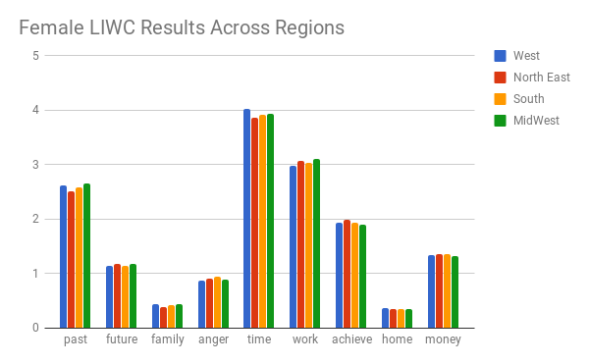
LIWC analysis for females across the region
West discusses Time more than any other
MidWest discusses more on Work while less on Achievements
North East discusses more on Achievements, Money and Future
South uses more Aggressive words and discusses more on Work, Money and Achievements.

Slide 17
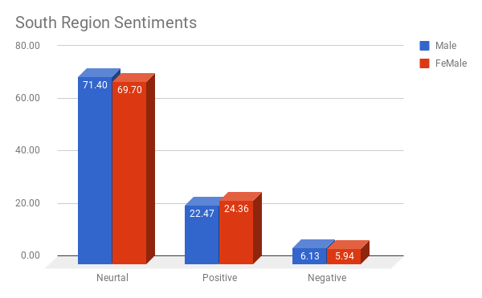
Sentiment analysis for south region

Slide 18
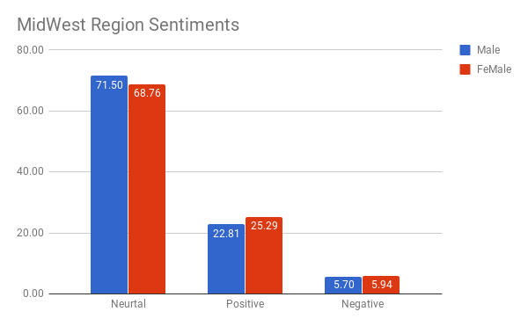
Sentiment analysis for midwest region

Slide 19
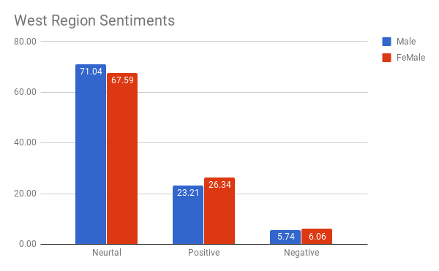
Sentiment analysis for west region

Slide 20
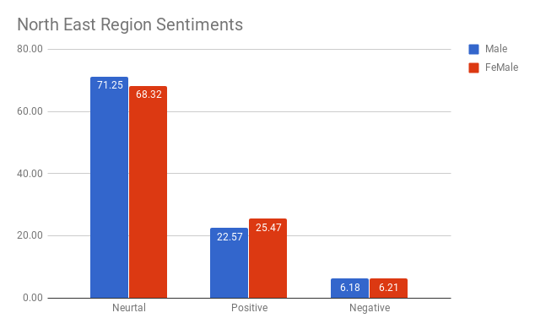
Sentiment analysis for north region

Slide 21
Conclusion

Slide 22
Thank You!

